Slide 1

croc

Slide 2

Software Assurance Analysis for Croc
By Adam Mills, Zexi Xing, Ernesto Macias, Zidong Liu, and Dennis Ugbebor

Slide 3
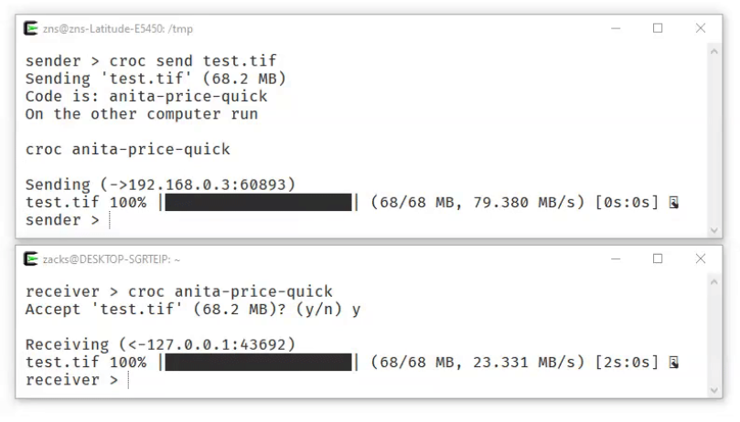
croc
croc is a simple tool for quick, secure, and simple file transfers between two computers
Allows any two computers to transfer data (using a relay)
Provides end-to-end encryption
Enables easy cross-platform transfers (Windows, Linux, Mac)
Allows multiple file transfers
Allows resuming transfers that are interrupted
Local server or port-forwarding not needed
Ipv6-first with ipv4 fallback
Can use proxy, like tor

Slide 4

Security Requirements - Gaps

Slide 5
Assurance Claims
Uploaded files to Croc are not accessible by un-Authorized users.
Support:
Croc’s passcode protection implementation
Passcode can be generated manually, or with Croc’s salted passcode generation algorithm
Passcode is strictly enforced and cannot be bypassed
Croc usage guide indicates best practices for sending files securely
Croc allows for secure network channel selection to greater guarantee privacy
Croc minimizes leakage of sensitive information during file transfer
Support:
End-to-end encryption
User can specific a handshaking protocol
Report is not logged in a file, only viewable immediately after transfer session
Rejection:
File transfer report shows network information such as IP address of sender/receiver

Slide 6
Assurance Claims (cont)
Croc can send multiple files at same time without compromise
Support:
Croc files cannot be written to while transfer is pending
Software is stable without observed crashes
Delivers file as-is
User guide has ample support and guidelines
Configuration chosen by file sender cannot be altered externally

Slide 7
Manual Code Review

Slide 8

Automated Scanning
Team attempted to use SonarQube

Slide 9
Ideas for Contributions for Croc’s Future

